Slide 1
Session 22
Overview of Signs and Symptoms

Slide 2
Learning Objectives
Describe possible effects that may be observed in each indicator of drug impairment
Identify effects most likely to be observed with subjects under the influence of each drug category

Slide 3
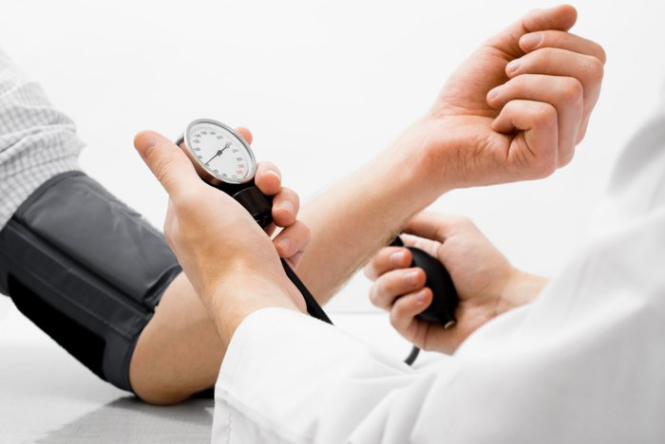
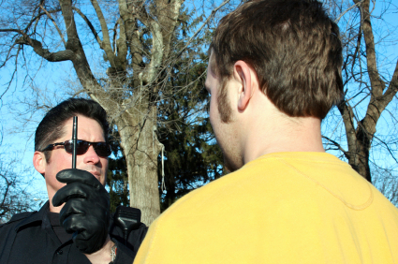
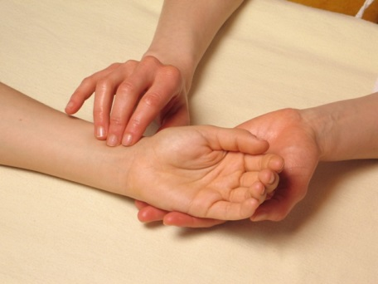
Major Indicators of Drug Impairment

Slide 4
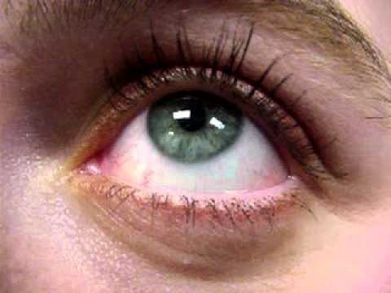
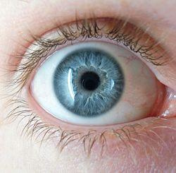
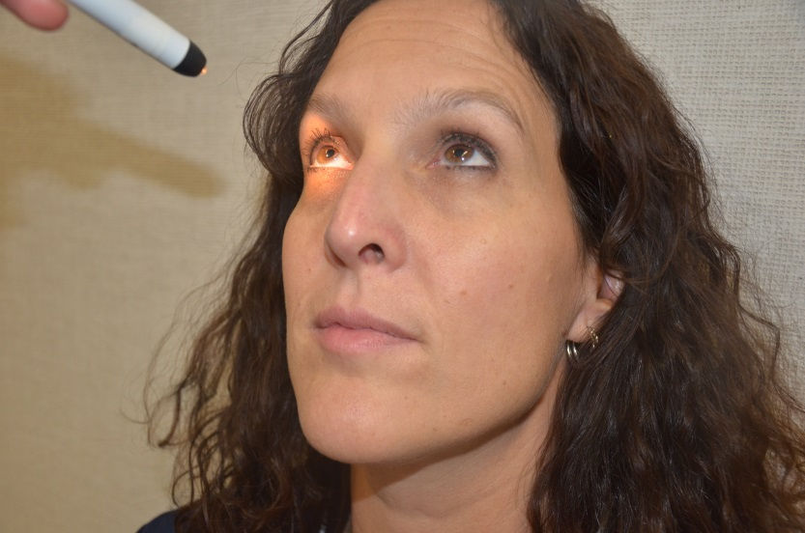
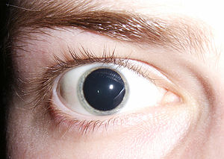
Eye Signs

Slide 5
Vital Signs
Pulse Rate, or Blood Pressure, or Body Temperature could be:
Normal
Up
Down

Slide 6
Muscle Tone
Normal
Flaccid
Rigid

Slide 7
 | CNS DEPRESS | CNS STIM | HALLUC | DISS ANESTHETIC | NARC ANALGESIC | INHALANT | CANNABIS
HGN | PRESENT | NONE | NONE | PRESENT | NONE | PRESENT | NONE
VGN | PRESENT | NONE | NONE | PRESENT | NONE | PRESENT | NONE
LOC | PRESENT | NONE | NONE | PRESENT | NONE | PRESENT | PRESENT
PUPIL SIZE | NORMAL | DILATED | DILATED | NORMAL | CONSTRICTED | NORMAL | DILATED OR POSSIBLY NORMAL
REACTION TO LIGHT | SLOW | SLOW | NORMAL | NORMAL | LITTLE OR NONE VISIBLE | SLOW | NORMAL
PULSE RATE | DOWN | UP | UP | UP | DOWN | UP | UP
BLOOD PRESSURE | DOWN | UP | UP | UP | DOWN | UP/DOWN | UP
BODY TEMPERATURE | NORMAL | UP | UP | UP | DOWN | UP/DOWN/ NORMAL | NORMAL
MUSCLE TONE | FLACCID | RIGID | RIGID | RIGID | FLACCID | NORMAL OR FLACCID | NORMAL

Slide 8
Questions?

